Slide 1





Pfizer Hemophilia: providing support to help manage
hemophilia for patients and their families
Established partnerships and long-term investments for innovative research
Hemophilia-specific support tools and educational resources for healthcare professionals and patients
Development of global support networks for healthcare professionals and patients

Slide 2

Celebrating 20+ years in the Canadian marketplace
A wealth of global experience
“Pfizer Canada has provided not only factor replacement therapies for the hemophilia community, they have also provided support through patient services and education.”
– Vanessa, Nurse
The Hospital for Sick Children, Toronto
“With Pfizer’s help, we have had the opportunity to help develop educational material that has traveled to developing countries.”
– Betty Ann, Nurse
Sudbury Regional Hospital
“Pfizer generously helps and supports the hemophilia community – tirelessly doing so for 20 years!”
– Claudine, Nurse
St. Justine Hospital, Montreal

Slide 3






Our long-standing collaborations with the hemophilia community

Slide 4

Our continued commitment to the community
Pfizer supports the global healthcare community’s independent initiatives (e.g., research, quality improvement and education) to improve patient outcomes in areas of unmet medical need that are aligned with Pfizer’s medical and/or scientific strategies.
CHS national and regional chapters multi-year sponsorship commitments:
Care Until Cure research program
Long-standing, financial and educational supporter of youth summer camps
Scholarship and bursary support

Slide 5

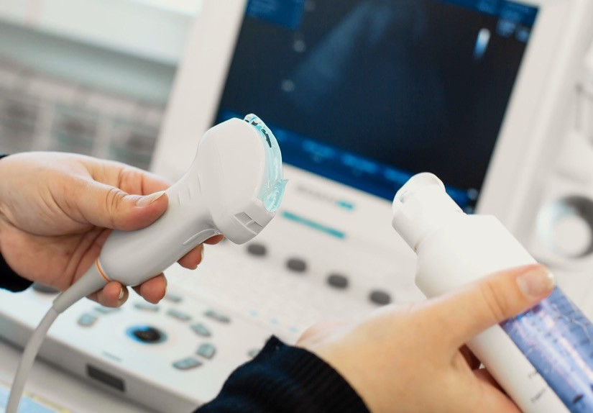
Our continued commitment to the community
Supporting clinics and patients with point of care ultrasound programs and machines
Founded in the year 2000, this program allows Canadian investigators to conduct research on medical and psychosocial aspects of bleeding disorders, including outcome evaluation
Educational support for healthcare practitioners in hemophilia
Pfizer Global Medical Grants recognize knowledge exchange as an important component of the continuing education continuum and offers support for these programs through independent medical education grants

Slide 6








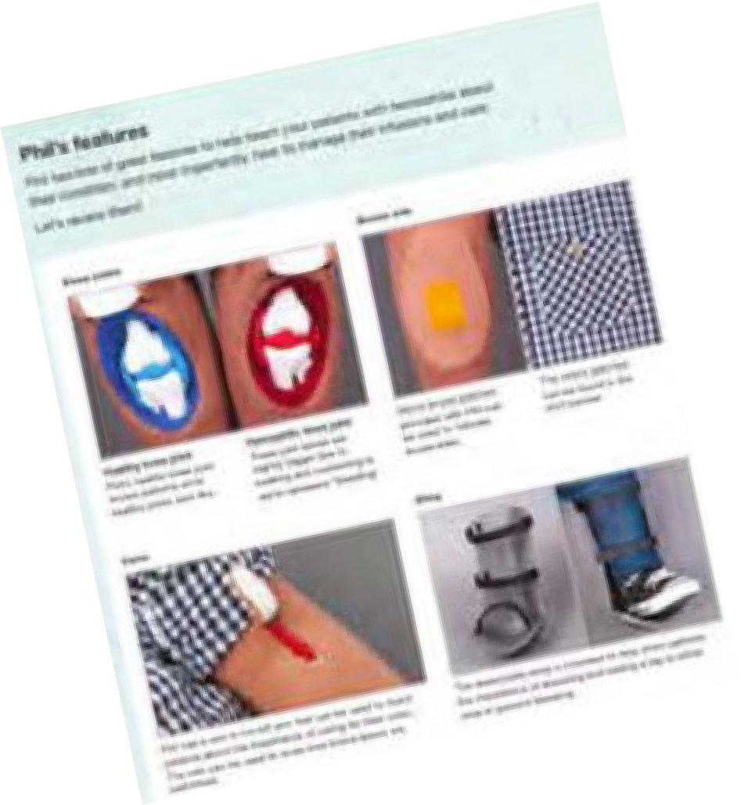




We are pleased to provide educational resources for patients
Helping our patients understand their disease and management options today for a better future tomorrow
Phil the Puppet
Phil Summer Camp Activity Book
Phil Teenager Comic
Phil Introduction Book
Phil’s 6- month Checkup
Phil Summer Camp

Slide 7









Tailored resources created to help healthcare professionals and patients with the management of hemophilia

Slide 8







Be Involved Patient Support Program
Who can benefit from the program? Service Offerings At-a-Glance
The elderly
In-home services to assist elderly patients
to infuse when they need to.
In-home nurse infusion assistance
Visits from a registered nurse, who offers in-home infusion assistance, education and support
Disabled patients
Patients with restricted mobility or
post-surgery may benefit from assistance from a trained professional.
Reimbursement and administrative assistance associated with patient disease state
Individualized support with insurance matters to obtain reimbursement for disease-related expenses
Guidance to help:
o navigate the reimbursement process
o review insurance forms
o answer all patient questions
Children with inadequate caregiver support Resources to help close the loop for young patients that may be lacking support at home.
Other patients who require in-home infusion related support Options available to help patients receive assistance from a trained healthcare professional in a manner that is convenient to them.

Slide 9


Committed to the future of the Hemophilia Therapy
Pfizer brings its expertise and breadth of resources to help the people and families affected by hemophilia.
We’ve been involved in the development of treatment for hemophilia for over 20 years.
Until there’s a cure, we will work tirelessly to continue to develop treatment options.

Slide 10

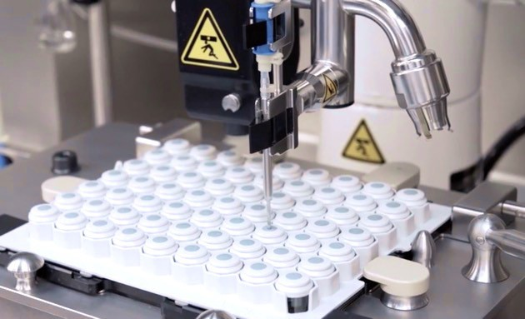
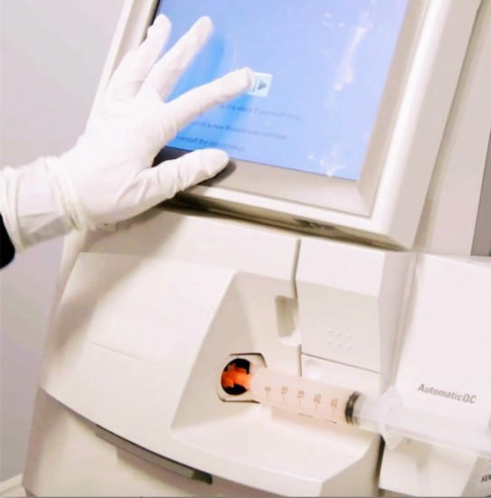
Committed to the future of the Hemophilia Therapy
Research and Development Facility
Chapel Hill, North Carolina
Pfizer’s Rare Disease Research Unit
Cambridge, Massachusetts
New Gene Therapy Facility
Sanford, North Carolina

Slide 11



Committed to the future of the Hemophilia Therapy
Helping improve QUALITY OF LIFE for patients is our goal
Research
Support programs
Educational resources

Slide 12


Pfizer Hemophilia Committed to supporting the hemophilia community for 20+ years and counting!
© 2021 Pfizer Canada ULC, Kirkland, Quebec H9J 2M5
| PP-HEM-CAN-0002-EN

